Slide 1
MNREGA Data Analysis and Visualization
Extracting Meaningful Insights for Policymakers and Administrators
Objective: Analyze and visualize the MNREGA dataset to extract meaningful insights.
Prepared by: Akash Kumar

Slide 2

Introduction to MNREGA
MNREGA, or the Mahatma Gandhi National Rural Employment Guarantee Act, is a landmark Indian law that provides a legal guarantee for 100 days of employment per year to rural households. This groundbreaking program aims to alleviate poverty and promote inclusive growth by ensuring access to basic work opportunities.

Slide 3
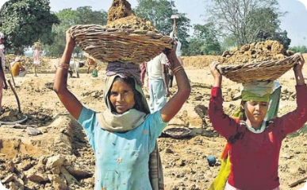
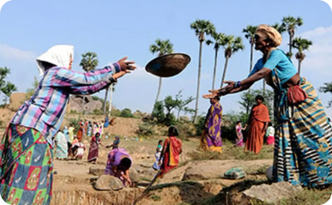
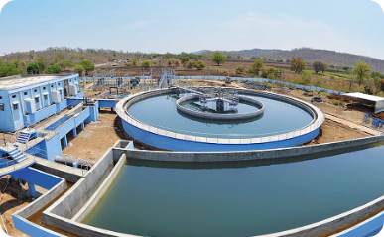
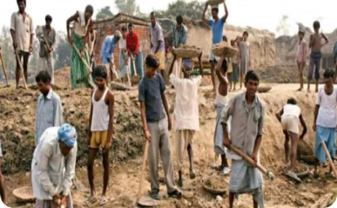
Key features of MGNREGA
Right to Work
Wage Guarantee
Focus on Rural Infrastructure
Decentralized Governance
The program guarantees 100 days of employment to any rural household willing to work.
The minimum daily wage is set by the government and varies by state.
The program prioritizes projects that benefit rural communities, such as water conservation, irrigation, and rural roads.
Local government bodies play a key role in planning, implementing, and monitoring MGNREGA projects.

Slide 4
Employment generation under MNREGA
1
Job Creation
2
Women's Participation
MNREGA aims to provide at least 100 days of guaranteed wage employment per year to every rural household. This helps generate significant employment opportunities in rural areas.
At least one-third of the beneficiaries under MNREGA are required to be women, promoting gender empowerment and financial inclusion.
3
Skilled Labor
4
Local Infrastructure
MNREGA projects utilize both skilled and unskilled labor, providing training and skill development opportunities to rural workers.
The works undertaken under MNREGA, such as building roads, canals, and other public assets, help strengthen rural infrastructure and create long-term community assets.

Slide 5
Data Preprocessing and Cleaning
Handling missing values
Correcting data inconsistencies
Standardizing data formats
Removing duplicates and irrelevant data
Overview:
Outcome: A clean and reliable dataset for analysis

Slide 6
Exploratory Data Analysis (EDA)
Descriptive Statistics:- Mean, median, mode, standard deviation
Correlation Analysis:- Relationships between key variables
Trend Analysis: - Changes in employment, expenditure, and wages over time
Distribution Analysis:- Spread and concentration of metrics such as persondays and job cards

Slide 7

Key Performance Indicators (KPIs)
List of KPIs:
Total Number of Job Cards Issued
Total Number of Active Workers
Active Workers
Average Wage Rate per Day per Person (Rs.)
Total Expenditure (Rs. in Lakhs)
Total wage

Slide 8
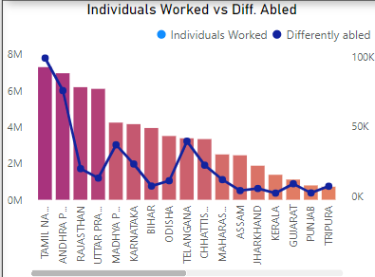
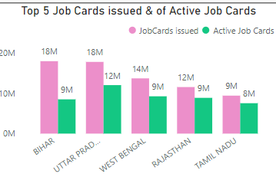
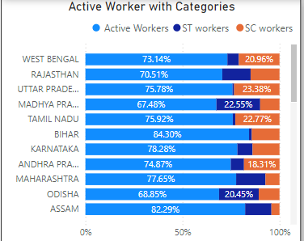
Active Job cards and with Categories
This Bars Shows The Top 5 Job Card Issues state V/S Active Job cards in those states
Here the comparison of the active Worker with their Categories
In this Visual the Individual Workers with the Differencialy Abled Woker in the States

Slide 9
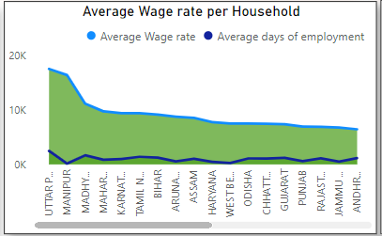
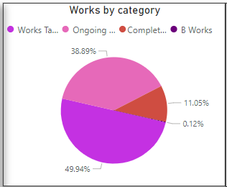
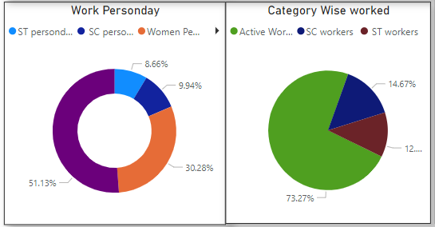
Work Analysis w.r.t categories Wage and HHS
With two Pies charts I can Easily get the insight from this Visual , in the 2nd chart what are the Perccentage of the Work Sc/St
In this Visual we get the AVG. Wage Rate and the AVG. Employment Generated
With two Pies charts I can Easily get the insight from this Visual , in the 1st chart what are the Perccentage of the Work Person on the basis of their Category
With This PIE Chart the Visuals Show the Works Created , Ongoing , Completed,and also Categories of the Work

Slide 10
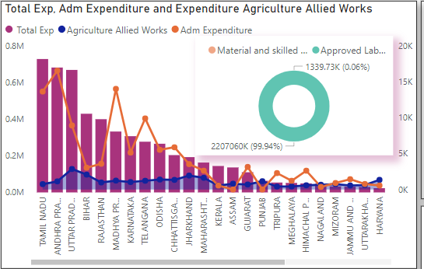
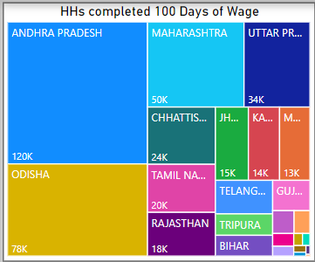
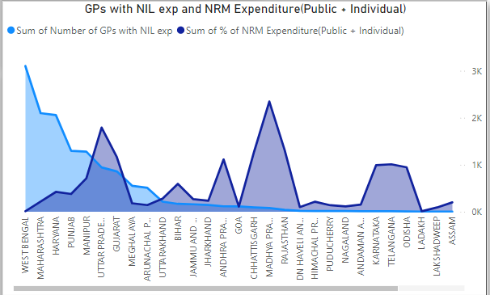
Expenditure on wage and Nill Expenditure
In this Bars Charts we can Easily see the Total Exp. And how many exp. On ADM , and Agriculture allied Works
With this Visuals we can Easily get in which state number of Nill Expendeture of GP and also the expenditure on Individual
With This Tree Map I want to Show How Many House Hold Completed the 100 Days of Wage w.r.t States

Slide 11
Thank you
Akash kumar
akashkrnishad111@gmail.com

